Slide 1
Agenda
Go to code.pyret.org/editor
Connect Pyret to Google Drive
Find shared document - Introduction to Pyret
“Open with” Pyret
Lesson begins at 20 after

Slide 2
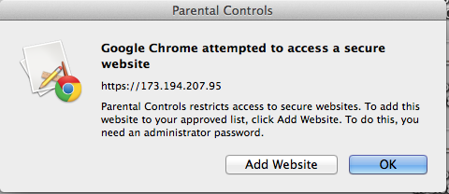
If you see this...
Click “Add Website”
Wait for me to come over to type password

Slide 3
Objective
Students will be able to...
Translate basic expressions between Racket and Pyret.
Follow design steps to write simple functions.

Slide 4
When you’re finished ... Create a Shoe!
Use the planning sheet to create a program for your favorite piece of footwear.
Plan it out before you implement.
Due Wednesday at the end of the period.

